Slide 1
[Organisation] · PHASE A
Solution Concept
Wave 1 — single customer view and claims modernisation
A pencil sketch. Enough to react to, not enough to build from.
Draft 0.1 · April 2027 · Owner: Chief Enterprise Architect

Slide 2
PURPOSE
What a solution concept is for
It exists to get a reaction before design money is spent. That means it has to be concrete enough to disagree with, and vague enough not to have decided anything.
Concrete enough to react to
Named capabilities, named systems, named actors. A stakeholder can point at the identity hub and say that is the wrong shape.
Vague enough to be honest
No product, no vendor, no deployment model, no data model. Precision at Phase A would be invented.
Shows what is NOT changing
Four systems of record are marked contained. That is the single most important thing on the page after two failed replacements.
Carries its alternatives
Three concepts were considered. A concept diagram with no rejected option is a decision already taken, presented as a picture.
The TOGAF term is a pencil sketch. It is the right description, and it is why this one has no technology on it.

Slide 3
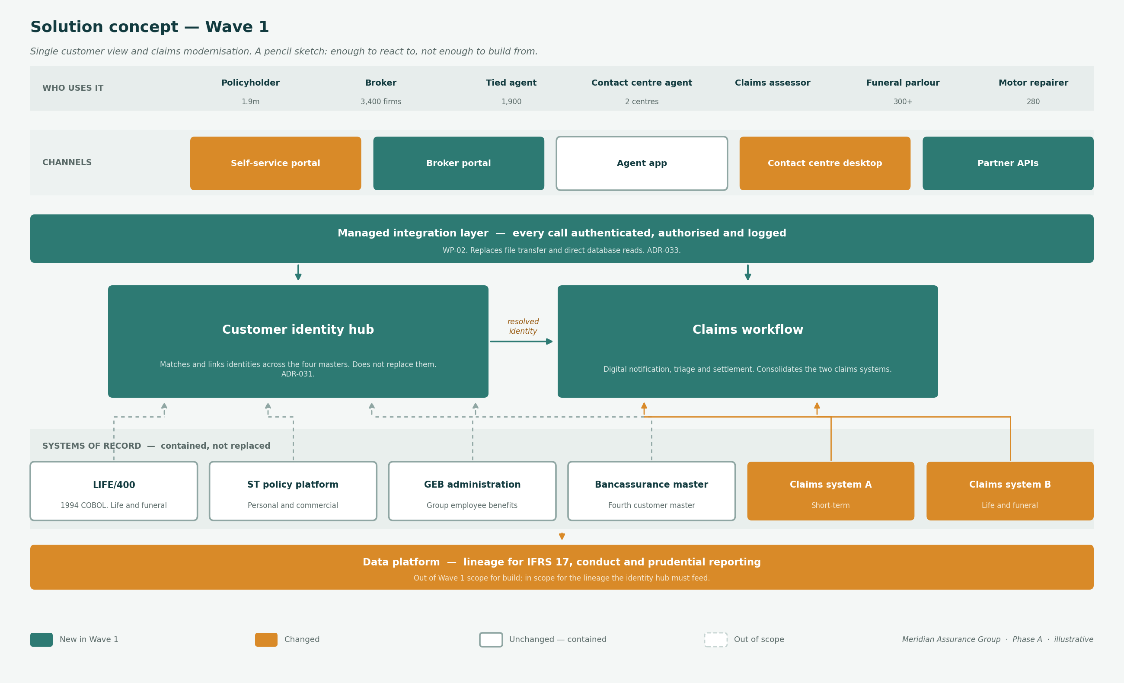
SOLUTION CONCEPT
Wave 1 — single customer view and claims modernisation
Green is new in Wave 1, amber is changed, outlined is contained and unchanged. Every source is drawn to the capability it actually feeds.

Slide 4
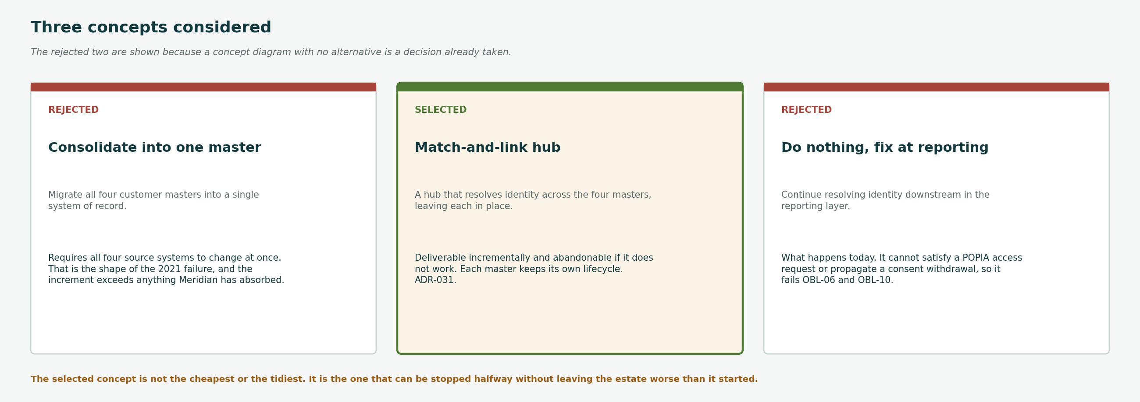
OPTIONS
Three concepts considered, two rejected
The selected concept is not the cheapest or the tidiest. It is the one that can be stopped halfway without leaving the estate worse than it started.

Slide 5
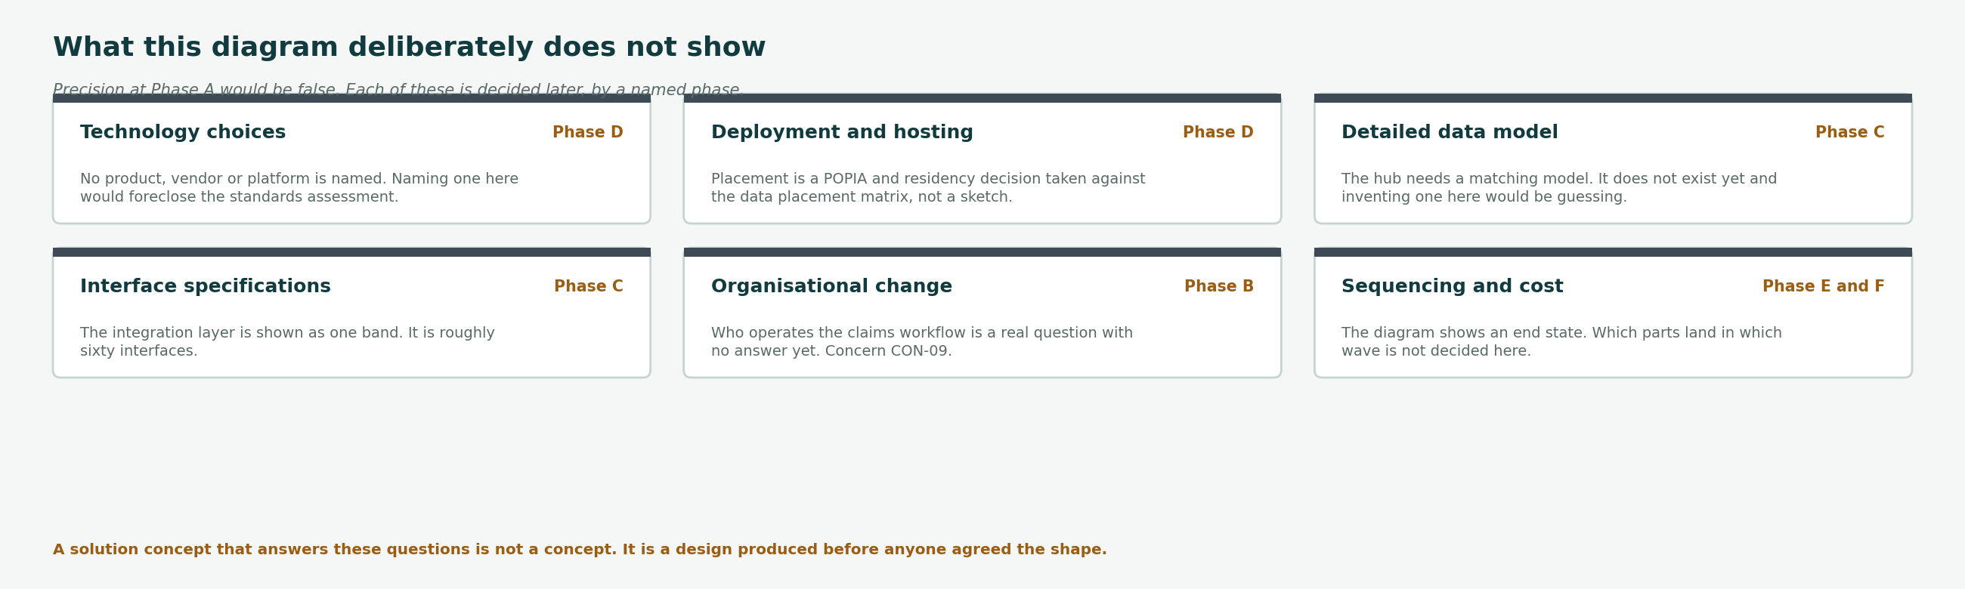
SCOPE
What this deliberately does not show
Each of these is decided later, by a named phase. A concept that answers them is a design produced before anyone agreed the shape.

Slide 6
TRACEABILITY
Which stakeholder concerns it answers
The concept is built to be shown. These are the concerns from the stakeholder map that it exists to test.
CON-06
Will a customer be known as one customer?
STK-14, STK-05, STK-07
The identity hub is the whole answer. If the shape is wrong, this is where it is caught.
CON-03
Who owns the customer record?
STK-07, STK-21
Not answered by the concept. The hub resolves identity; it does not designate ownership. That is the Data Governance Council.
CON-01
Will this be a third failed transformation?
STK-01, STK-02, STK-18
Four systems marked contained, and a concept that can be stopped halfway. That is the argument.
CON-04
Does architecture slow delivery?
STK-06, STK-09, STK-22
A one-page sketch at Phase A rather than a design. The concept is the evidence.
CON-09
What happens to roles when servicing automates?
STK-32, STK-27
Not shown, and no owner. The concept makes the omission visible rather than closing it.
Two of the five are open. A concept diagram that closed every concern would be claiming more than a sketch can carry.

Slide 7
NEXT
What happens to this next
The concept is an input to a decision, not a deliverable in itself. It has three destinations and one expiry.
1
Shown to the eleven key players
Before it goes anywhere else
The point is to be told the shape is wrong while changing it is still cheap.
2
Attached to the Statement of Architecture Work
Phase A close
Template T-01 requires a solution concept. This is it.
3
Superseded at Phase B
When the business architecture lands
The concept is not maintained. It is replaced by architecture, and the ADR records what it decided.
4
Expires if not used
Q3 2027
A concept that has sat for two quarters describes an estate that has moved. Redraw rather than trust it.
Solution concept diagrams are usually kept long after they stopped being true. Giving this one an expiry is cheaper than discovering it is stale at a gate.

